Slide 1
Community Analysis in Social Networks

Slide 2
Outline
What ?
Why ?
How ?
to obtain the structure
to evaluate the identified result

Slide 3
Community structure
groups of vertices within which connections are dense but between which they are sparser.
a.k.a. group, community, cluster, module in different contexts
Within-group( intra-group) edges.
High density
Between-group( inter-group) edges.
Low density.
Notes:
Difference between clustering and community structure detection.
Clustering is dividing the data points into classes according to some similarity measure.
Community structure: dividing the network into groups according to structural info.( connectivity).

Slide 4
Community structure

Slide 5
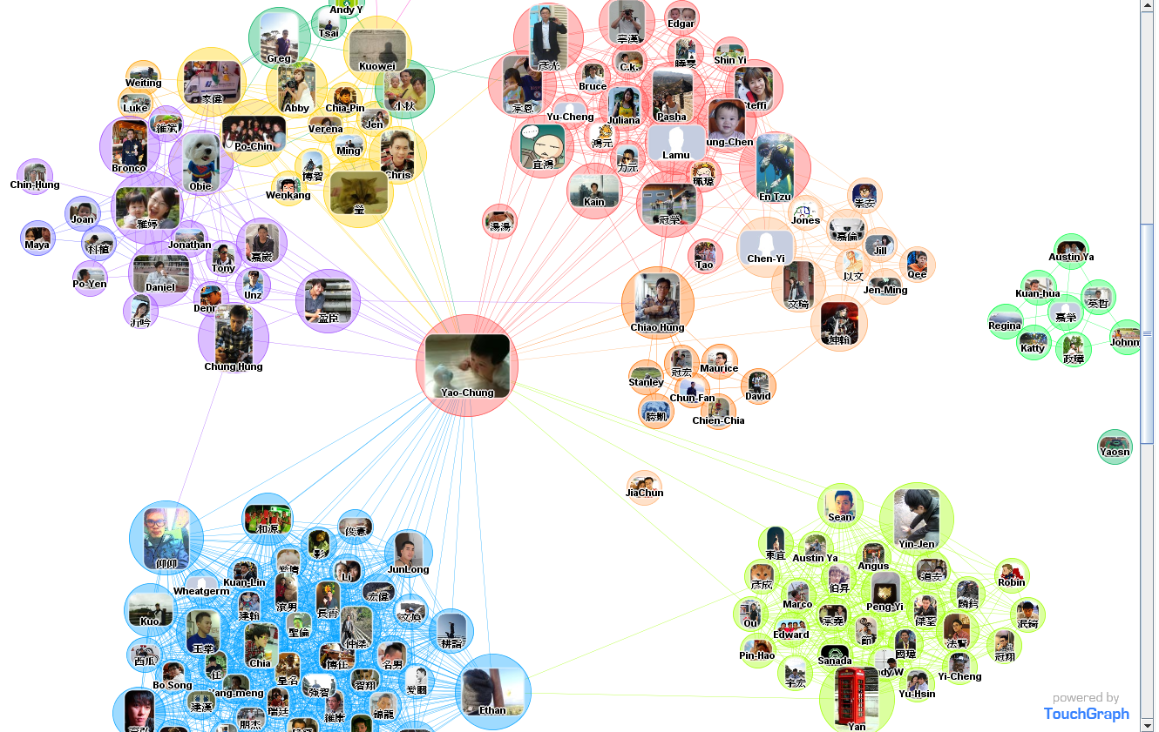

Slide 6
Community
Two types of groups in social media
Explicit Groups: formed by user subscriptions
Implicit Groups: implicitly formed by social interactions
Network interaction provides rich information about the relationship between users
Can complement other kinds of information, e.g. user profile
Help network visualization and navigation
Provide basic information for other tasks, e.g. recommendation

Slide 7
The objective
Divide the network into non-empty groups (communities) in such a way that every vertex belongs to one of the communities.
Many possible divisions could be done.
We need a good division.
Measurement of good division.

Slide 8
Community Detection Algorithms
Graph partitioning Algorithm
The Clique Percolation Method
The Kernighan-Lin (KL) algorithm
Structural Similarity Algorithm
Edge Removal Algorithm
Randomized Algorithm

Slide 9
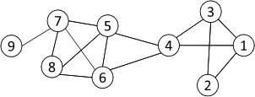
Cliques
Nodes 5, 6, 7 and 8 form a clique
9
Maximum Clique: a maximum complete subgraph in which all nodes are adjacent to each other
Straightforward implementation to find cliques is very expensive in time complexity

Slide 10
Clique Percolation Method (CPM)
Clique is a very strict definition
Normally use cliques as a core or a seed to find larger communities
CPM is a method to find overlapping communities
Input
A parameter k, and a network
Procedure
Find out all cliques of size k in a given network
Construct a clique graph. Two cliques are adjacent if they share k-1 nodes
Each connected components in the clique graph form a community

Slide 11
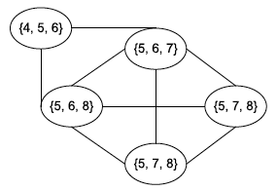
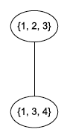
CPM Example
Cliques of size 3:
{1, 2, 3}, {1, 3, 4}, {4, 5, 6}, {5, 6, 7}, {5, 6, 8}, {5, 7, 8},
{6, 7, 8}
Communities:
{1, 2, 3, 4}
{4, 5, 6, 7, 8}

Slide 12
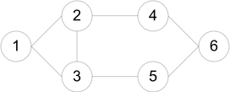
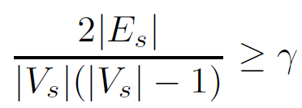
Many Variants of CPM method
k-clique: a maximal subgraph in which the largest distance between any two nodes <= k in the original graph
k-club: a substructure of diameter <= k
Clique is a very strict definition
A subgraph is a quasi-clique if
where the denominator is the maximum number of degrees.
Cliques: {1, 2, 3}
2-cliques: {1, 2, 3, 4, 5}, {2, 3, 4, 5, 6}
2-clubs: {1,2,3,4}, {1, 2, 3, 5}, {2, 3, 4, 5, 6}

Slide 13
Community Detection Algorithms
Graph partitioning Algorithm
The Clique Percolation Method
The Kernighan-Lin (KL) algorithm
Structural Similarity Algorithm
Edge Removal Algorithm
Randomized Algorithm
Notes:
Graph partitioning is iterative bisection: dividing the graph into 2 groups and then subdivide each group until we have the required # of groups.

Slide 14
Community Detection Algorithms
Graph partitioning Algorithm
The Clique Percolation Method
The Kernighan-Lin (KL) algorithm
Structural Similarity Algorithm
Edge Removal Algorithm
Randomized Algorithm
Notes:
Graph partitioning is iterative bisection: dividing the graph into 2 groups and then subdivide each group until we have the required # of groups.

Slide 15
KL algorithm

Slide 16

Cut !!!!

Slide 17
Cut
How to find a cut ?
Kernighan-Lin (KL) algorithm
Most interactions are within group whereas interactions between groups are few
community detection → minimum cut problem
Cut: A partition of vertices of a graph into two disjoint sets
Minimum cut problem: find a graph partition such that the number of edges between the two sets is minimized

Slide 18
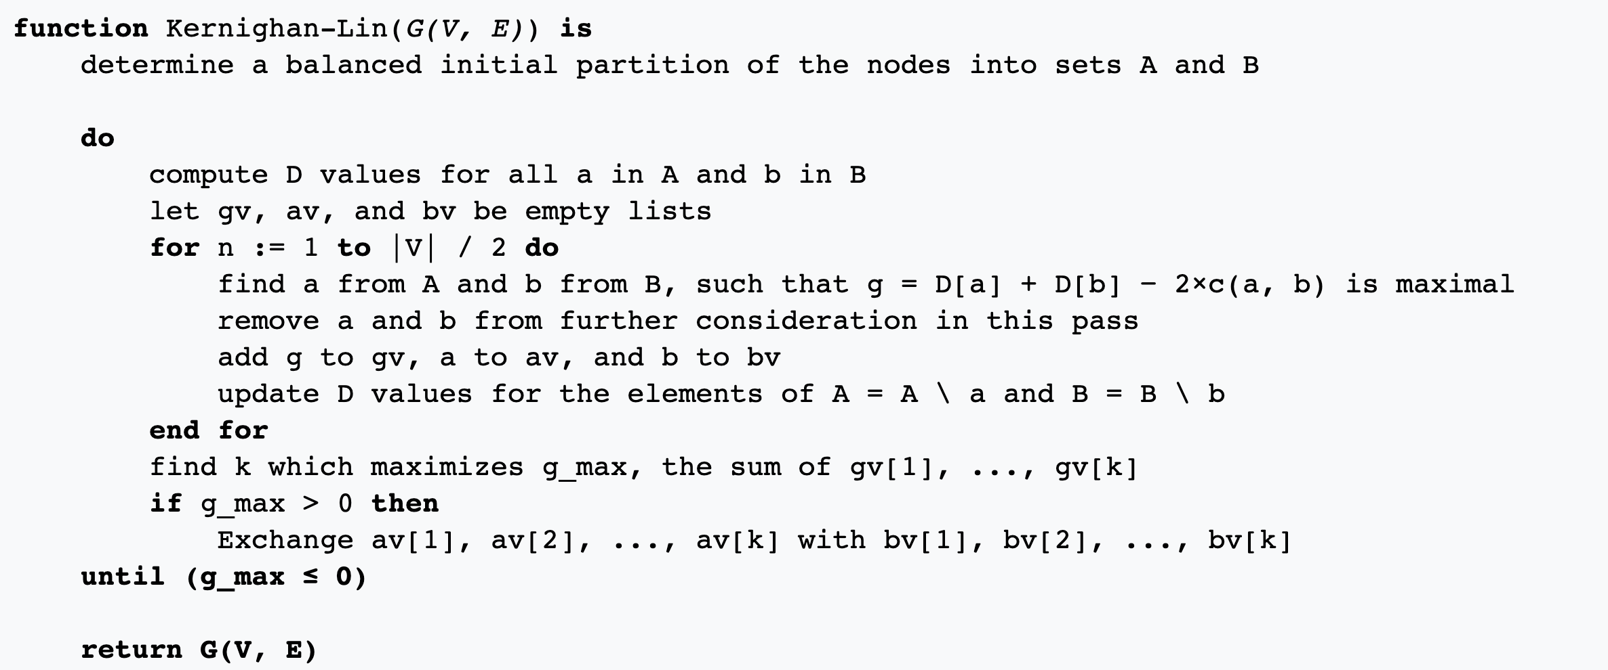
Kernighan-Lin (KL) algorithm

Slide 19
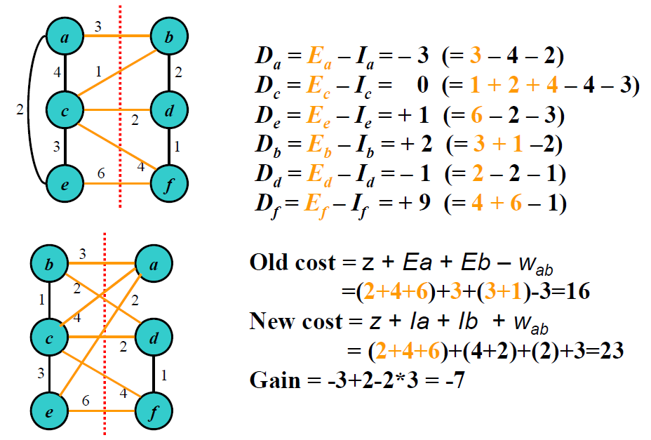
Kernighan-Lin (KL) algorithm
Swap a and b
Better or Not?

Slide 20
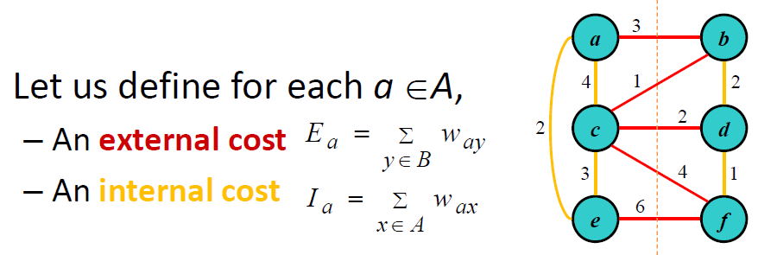
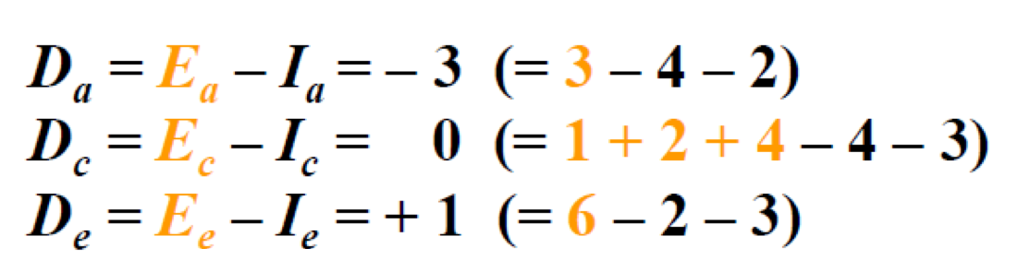
Kernighan-Lin (KL) algorithm
A
B
Let D_{z}=E_{z}‐I_{z} for a node z;
D_{z} is the difference between its external and internal costs for node z

Slide 21
Kernighan-Lin (KL) algorithm

Slide 22
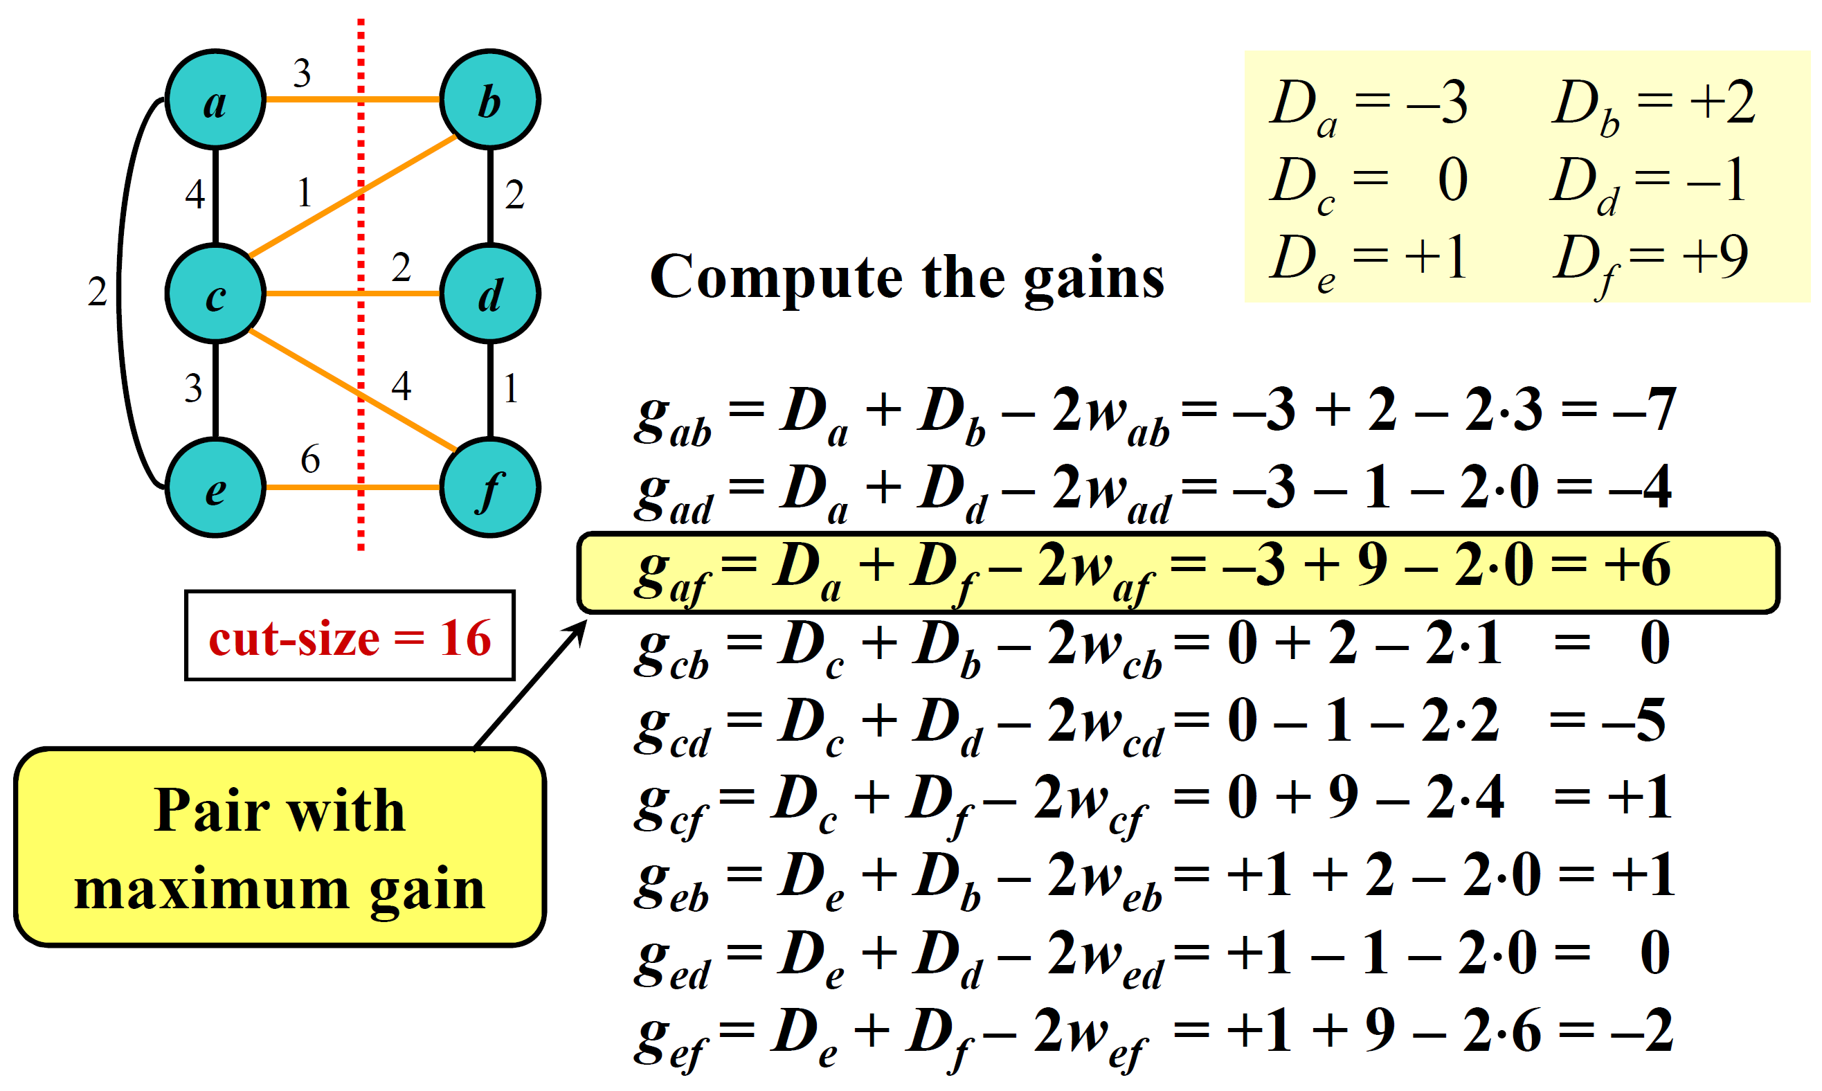
Kernighan-Lin (KL) algorithm

Slide 23
Kernighan-Lin (KL) algorithm

Slide 24
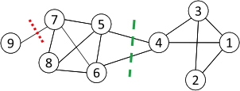
Min Cut ?
Minimum cut often returns an imbalanced partition, with one set being a singleton, e.g. node 9

Slide 25
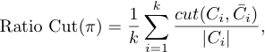
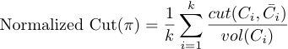
Ratio Cut & Normalized Cut
Change the objective function to consider community size
C_{i,}: a community
|C_{i}|: number of nodes in C_{i}
vol(C_{i}): sum of degrees in C_{i}

Slide 26
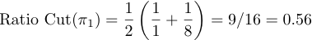
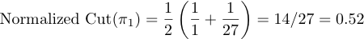
Ratio Cut & Normalized Cut Example
For partition in red:
For partition in green:
Both ratio cut and normalized cut prefer a balanced partition

Slide 27


Slide 28
Community Detection Algorithms
Graph partitioning Algorithm
The Clique Percolation Method
The Kernighan-Lin (KL) algorithm
Structural Similarity Algorithm
Edge Removal Algorithm
Randomized Algorithm
Notes:
Graph partitioning is iterative bisection: dividing the graph into 2 groups and then subdivide each group until we have the required # of groups.

Slide 29
Clustering based on Vertex Similarity
Apply k-means or similarity-based clustering to nodes
Vertex similarity is defined in terms of the similarity of their neighborhood
Structural equivalence: two nodes are structurally equivalent iff they are connecting to the same set of actors
Nodes 1 and 3 are structurally equivalent;
So are nodes 5 and 6.

Slide 30
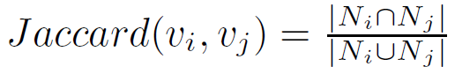
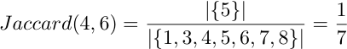
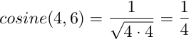
Vertex Similarity
Jaccard Similarity
Cosine similarity

Slide 31
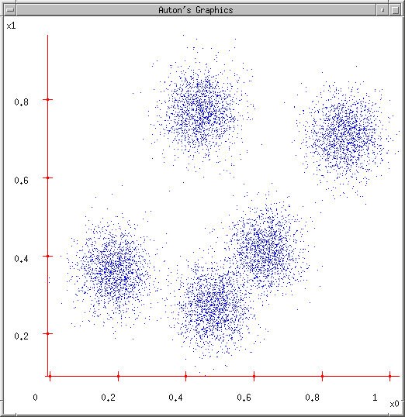
K-means illustration
User set up the number of clusters they’d like. (e.g. k=5)

Slide 32
K-means illustration
User set up the number of clusters they’d like. (e.g. K=5)
Randomly guess K cluster Center locations

Slide 33
K-means illustration
User set up the number of clusters they’d like. (e.g. K=5)
Randomly guess K cluster Center locations
Each data point finds out which Center it’s closest to. (Thus each Center “owns” a set of data points)

Slide 34
K-means illustration
User set up the number of clusters they’d like. (e.g. K=5)
Randomly guess K cluster centre locations
Each data point finds out which centre it’s closest to. (Thus each Center “owns” a set of data points)
Each centre finds the centroid of the points it owns

Slide 35
K-means illustration
User set up the number of clusters they’d like. (e.g. K=5)
Randomly guess K cluster centre locations
Each data point finds out which centre it’s closest to. (Thus each centre “owns” a set of data points)
Each centre finds the centroid of the points it owns
…and jumps there

Slide 36
K-means illustration
User set up the number of clusters they’d like. (e.g. K=5)
Randomly guess K cluster centre locations
Each data point finds out which centre it’s closest to. (Thus each centre “owns” a set of data points)
Each centre finds the centroid of the points it owns
…and jumps there
…Repeat until terminated!

Slide 37
Graph/Vertex Embedding

Slide 38
Vertex Embedding

Slide 39
Idea behind the Neural Embedding Representation

Slide 40
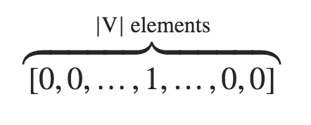
f(word) =
Encode a word into a vector representation
A possible way is one-hot-encoding form
That is, we represent the word w by
where the 1 is in a location unique to w. Any other word will have a 1 in some other location, and a 0 everywhere else.

Slide 41
Main Problem (1/2)
The mathematician ran to the coffee store.
The physicist ran to the coffee store.
The mathematician and physicist ran into the open problem.
Let’s think one-hot-form of ”mathematician” and “physicist” ?
Physicist = [0, 0, 0, 0, 0, 1]
mathematician = [0, 0, 0, 0, 1, 0]
ran=[0, 0, 0, 1, 0, 0]
store=[0, 0, 1, 0, 0, 0]
coffee=[0, 1, 0, 0, 0, 0]
problem=[1, 0, 0, 0, 0, 0]
Semantic Similarity ?

Slide 42
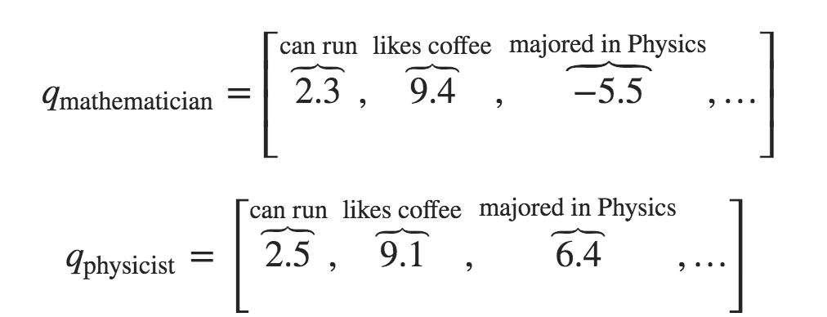
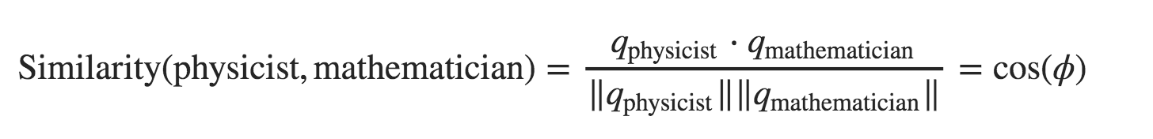
Main Problem (2/2)
How can we solve this problem? That is, how could we actually encode semantic similarity in words? Maybe we think up some semantic attributes.
For example, we see that both mathematicians and physicists can run, so maybe we give these words a high score for the “is able to run” semantic attribute
If each attribute is a dimension, then we might give each word a vector, like this:

Slide 43
→
A Matrix can help !
w_{word}
e_{word}
w_{word}・V = e_{word}
・
=
Q: How to get V ?
A: Learning from Data
w_{word}
e_{word}
V

Slide 44
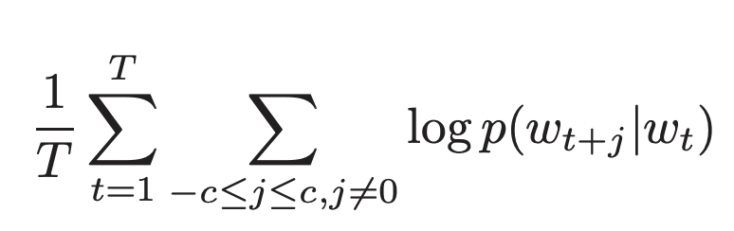
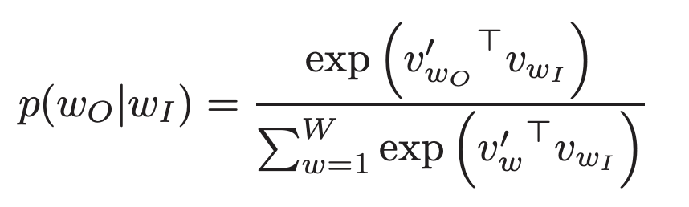
1
2
3
4
5
6
7
8
9
1 | 2 | 3 | 4 | 5 | 6 | 7 | 8 | 9 | 10
1 | 2 | 3 | 4 | 5 | 6 | 7 | 8 | 9
10
1 | 2 | 3 | 4 | 5 | 6 | 7 | 8 | 9 | 10
・
・
=
V’
10
V
Objective Function

Slide 45
1
2
3
4
5
6
7
8
9
1 | 2 | 3 | 4 | 5 | 6 | 7 | 8 | 9 | 10
1 | 2 | 3 | 4 | 5 | 6 | 7 | 8 | 9
10
1 | 2 | 3 | 4 | 5 | 6 | 7 | 8 | 9 | 10
・
・
=
V’
10
V
1
2
10
5
5
……
5

Slide 46
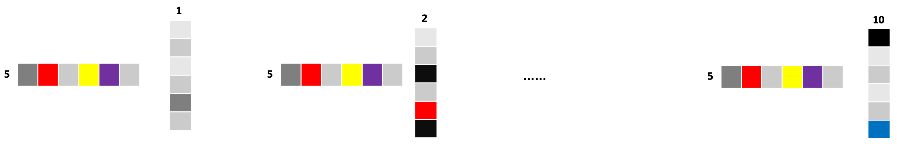
1
2
3
4
5
6
7
8
9
1 | 2 | 3 | 4 | 5 | 6 | 7 | 8 | 9 | 10
1 | 2 | 3 | 4 | 5 | 6 | 7 | 8 | 9
10
1 | 2 | 3 | 4 | 5 | 6 | 7 | 8 | 9 | 10
・
・
=
V’
10
V
e
=
e
e
e
+ …… +

Slide 47
Graph Embedding
DeepWalk: Online Learning of Social Representations, KDD 2014

Slide 48
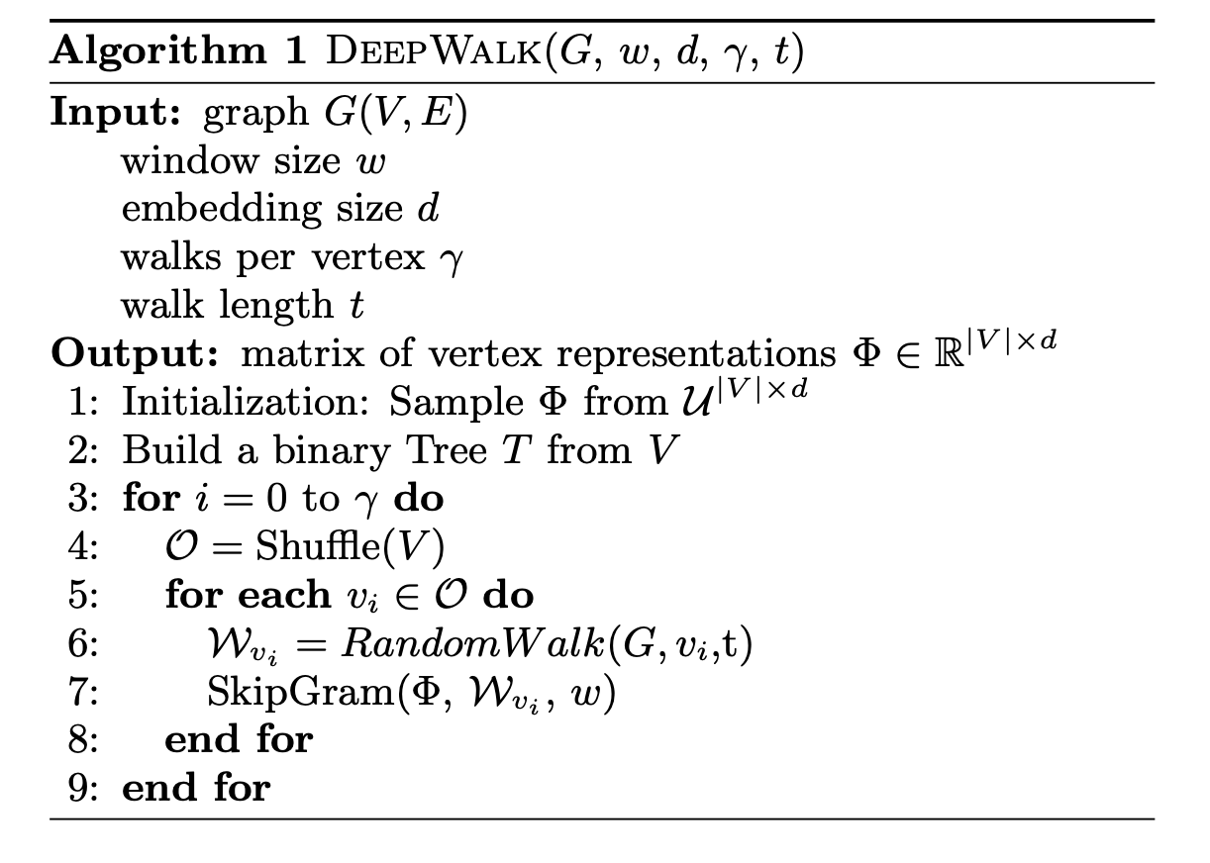
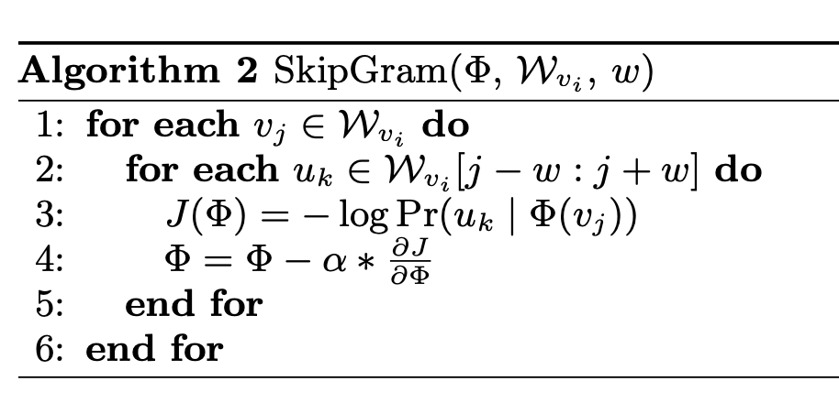

Slide 49
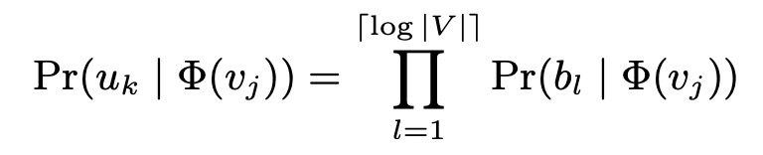
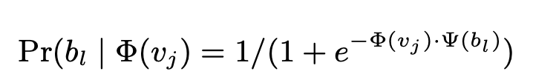
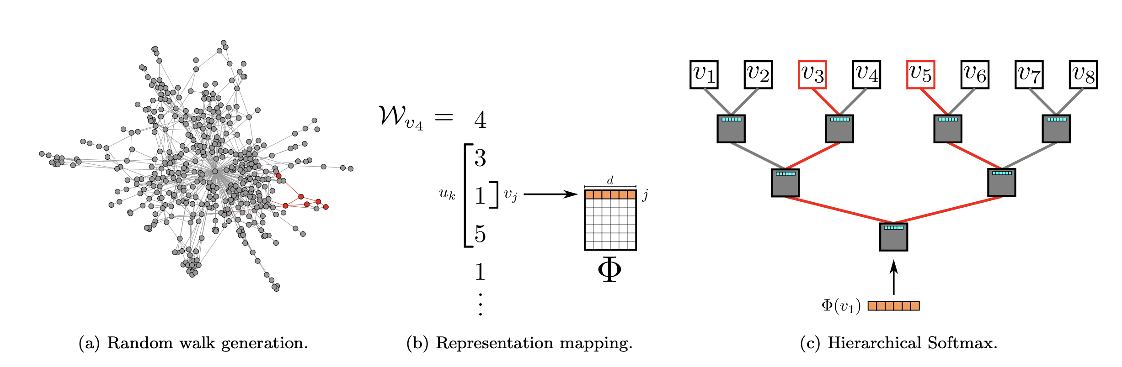

Slide 50
Community Detection Algorithms
Graph partitioning Algorithm
The Clique Percolation Method
The Kernighan-Lin (KL) algorithm
Structural Similarity Algorithm
Edge Removal Algorithm
Randomized Algorithm
Notes:
Graph partitioning is iterative bisection: dividing the graph into 2 groups and then subdivide each group until we have the required # of groups.

Slide 51
Edge Removal Algorithm

Slide 52
Edge Removal Algorithm
By defining a measure to rank the nodes
By degree ?
By clustering coefficient ?
By betweeness ?

Slide 53
By Detweeness
ratio of the number of shortest paths passing through a node v out of all shortest paths between all node pairs in a network
betweenness of vertex i
shortest paths between j and k that pass through i
all shortest paths between j and k
i
k
j

Slide 54
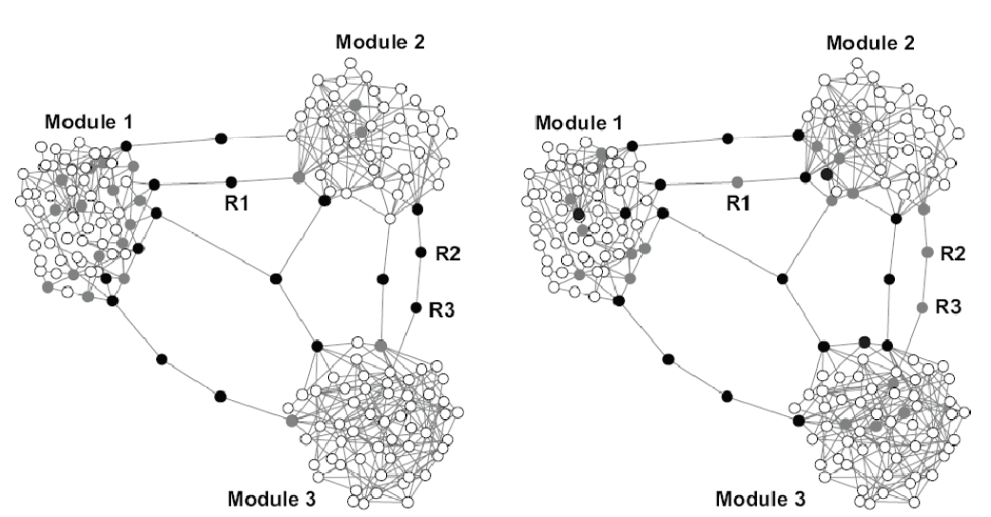
By Detweeness ?

Slide 55
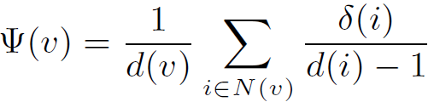
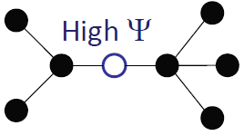
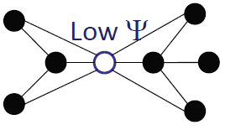
Bridging coefficient
δ(i) = |N(i)-N(v)-v|
For node v:
The probability of leaving the direct neighbors of a node v.
i
v
v
v
Bridging Coefficient: a measurement that measuring the extent how well a node or edge is located between well connected regions.

Slide 56
Experiment
Bridging centrality
Betweenness centrality

Slide 57
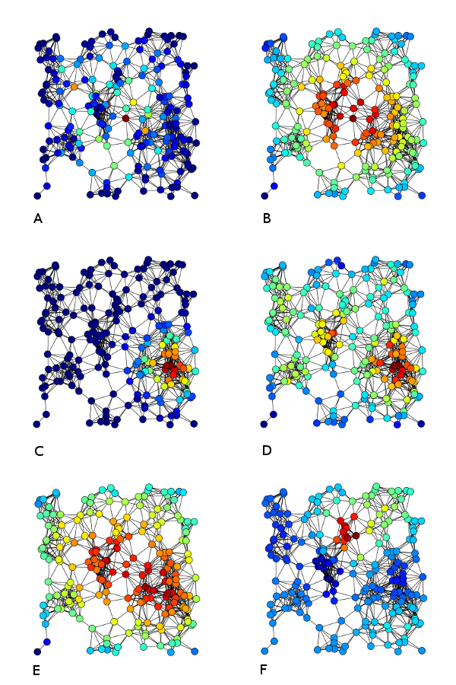
Examples of
A) Betweenness centrality,
B) Closeness centrality,
C) Eigenvector centrality,
D)Degree centrality,
E) Harmonic centrality
F) Katz centrality of the same graph

Slide 58
Edge Betweenness
The edge betweenness of e(1, 2) is 4 (=6/2 + 1), as all the shortest paths from 2 to {4, 5, 6, 7, 8, 9} have to either pass e(1, 2) or e(2, 3), and e(1,2) is the shortest path between 1 and 2
58
The strength of a tie can be measured by edge betweenness
Edge betweenness: the number of shortest paths that pass along with the edge
The edge with higher betweenness tends to be the bridge between two communities.
Notes:
Nodes 4-9 have two paths to reach Node2: e(1,2) and e(2,3), hence, 6/2 = 3, Node 3 can reach Node 2 directly, and Node 1 reaches Node 2 via e(1,2). Hence, edge betweenness of e(1,2) is 4.
58

Slide 59
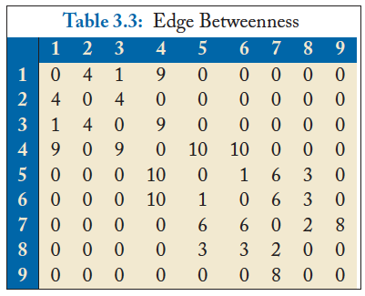
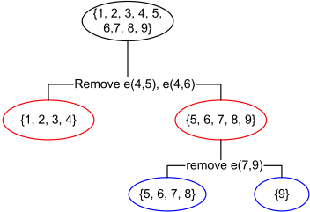
Divisive clustering based on edge betweenness
Initial betweenness value
After remove e(4,5), the betweenness of e(4, 6) becomes 20, which is the highest;
After remove e(4,6), the edge e(7,9) has the highest betweenness value 4, and should be removed.
Idea: progressively removing edges with the highest betweenness
59

Slide 60
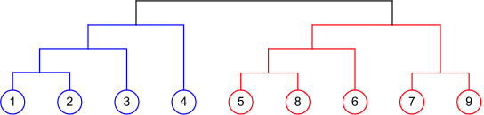
Agglomerative Hierarchical Clustering
60
Initialize each node as a community
Merge communities successively into larger communities following a certain criterion

Slide 61
Community Detection Algorithms
Graph partitioning Algorithm
The Clique Percolation Method
The Kernighan-Lin (KL) algorithm
Structural Similarity Algorithm
Edge Removal Algorithm
Randomized Algorithm
Notes:
Graph partitioning is iterative bisection: dividing the graph into 2 groups and then subdivide each group until we have the required # of groups.

Slide 62
What is a Random Walk?
Given a graph and a starting point (node), we select a neighbor of it at random, and move to this neighbor;
Then we select a neighbor of this node and move to it, and so on;
The (random) sequence of nodes selected this way is a random walk on the graph

Slide 63
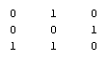
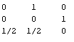
An example
Adjacency matrix A
Transition matrix P
B
1
1
1
1/2
1
1
A
1
C
1/2
Slide from Purnamitra Sarkar, Random Walks on Graphs: An Overview

Slide 64

An example
t=0, A
B
1
1/2
A
1
1/2
C
Slide from Purnamitra Sarkar, Random Walks on Graphs: An Overview

Slide 65
An example
t=0, A
t=1, AB
B
1
1
1/2
1/2
A
1
1
1/2
C
1/2
Slide from Purnamitra Sarkar, Random Walks on Graphs: An Overview

Slide 66

An example
t=0, A
t=1, AB
B
1
1
1/2
1/2
A
1
1
1/2
C
1/2
t=2, ABC
1
1/2
1
1/2
Slide from Purnamitra Sarkar, Random Walks on Graphs: An Overview

Slide 67


An example
t=0, A
t=1, AB
B
1
1
1/2
1/2
A
1
1
1/2
C
1/2
t=2, ABC
t=3, ABCA
ABCB
1
1/2
1
1
1/2
1
1/2
1/2
Slide from Purnamitra Sarkar, Random Walks on Graphs: An Overview

Slide 68
Random walk with restart
10
9
12
2
1
8
3
11
4
6
5
7

Slide 69
Random walk with restart
0.04
0.03
 | Node 4
Node 1 Node 2 Node 3 Node 4 Node 5 Node 6 Node 7 Node 8 Node 9 Node 10 Node 11 Node 12 | 0.13 0.10 0.13 0.22 0.13 0.05 0.05 0.08 0.04 0.03 0.04 0.02
10
0.10
9
12
0.13
2
0.08
0.02
1
8
0.13
11
3
0.04
4
0.05
6
5
0.13
7
0.05
Nearby nodes, higher scores
Ranking vector
More red, more relevant

Slide 70
Community Detection Algorithms
Graph partitioning Algorithm
The Clique Percolation Method
The Kernighan-Lin (KL) algorithm
Structural Similarity Algorithm
Edge Removal Algorithm
Randomized Algorithm

Slide 71
Measuring a clustering/community Result
1, 2, 3
4, 5, 6
1, 3
2
4, 5, 6
Ground Truth
Clustering Result
How to measure the
clustering quality?
The number of communities after grouping can be different from the ground truth
No clear community correspondence between clustering result and the ground truth
Notes:
71

Slide 72
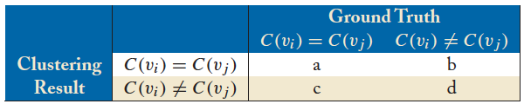
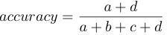
Accuracy of Pairwise Community Memberships
Consider all the possible pairs of nodes and check whether they reside in the same community
An error occurs if
Two nodes belonging to the same community are assigned to different communities after clustering
Two nodes belonging to different communities are assigned to the same community
Construct a contingency table or confusion matrix

